Slide 1
Face recognition
Siamese Networks

Slide 2
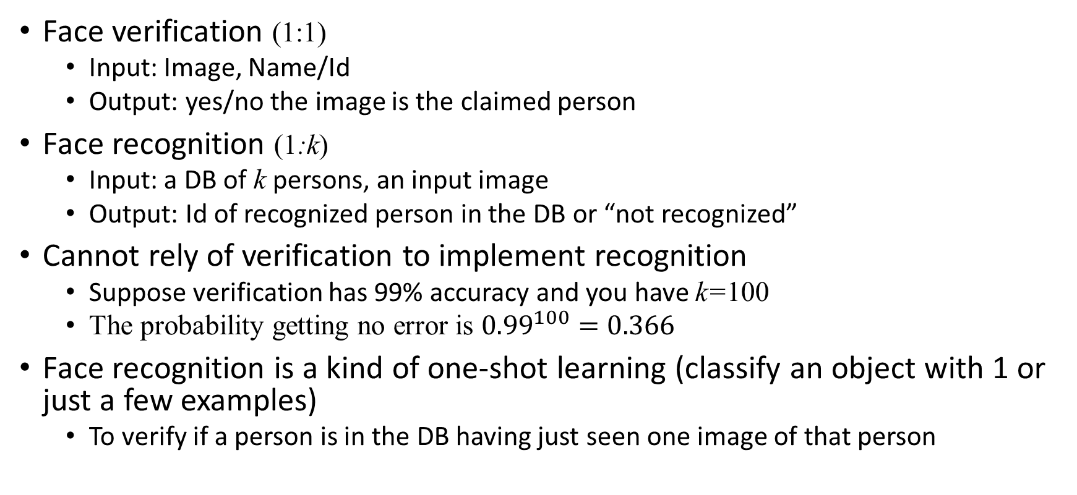
Verification vs recognition
Face verification (1:1)
  Input: Image, Name/Id
  Output: yes/no the image is the claimed person
Face recognition (1:k)
  Input: a DB of k persons, an input image
  Output: Id of recognized person in the DB or “not recognized”
Cannot rely of verification to implement recognition
  Suppose verification has 99% accuracy and you have k=100
  The probability getting no error is ${0.99}^{100}=0.366$
Face recognition is a kind of one-shot learning (classify an object with 1 or just a few examples)
  To verify if a person is in the DB having just seen one image of that person

Slide 3
One-shot learning
To verify if an image is in the DB having just seen that image once
E.g.:
  a DB with one picture of every company’s employee (training set 1 picture for every person)
  Given a query picture, to recognize whether it is an employee or not
Bad Idea:
  Train a CNN with a softmax with N output if N employees
  Training set is to small
  When changing the number of employees, need to change the output layer
Alternative: learning a similarity function

Slide 4
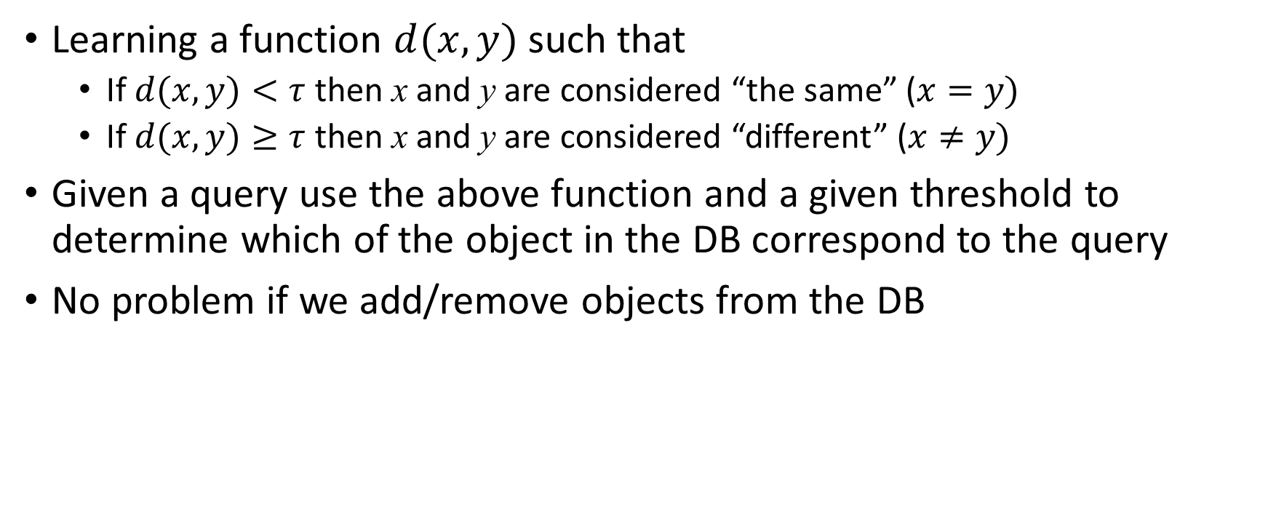
Similarity/distance function
Learning a function $d(x,y)$ such that
  If $d(x,y)<τ$ then x and y are considered “the same” ($x=y)$
  If $d(x,y)≥τ$ then x and y are considered “different” ($x≠y)$
Given a query use the above function and a given threshold to determine which of the object in the DB correspond to the query
No problem if we add/remove objects from the DB

Slide 5
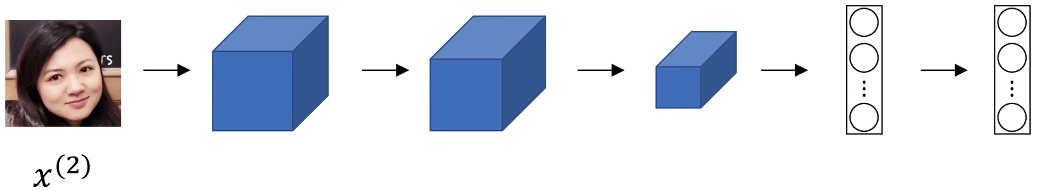


Siamese networks
Feature embeddings $f(x^{(1)})$
Feature embeddings $f(x^{(2)})$

Slide 6
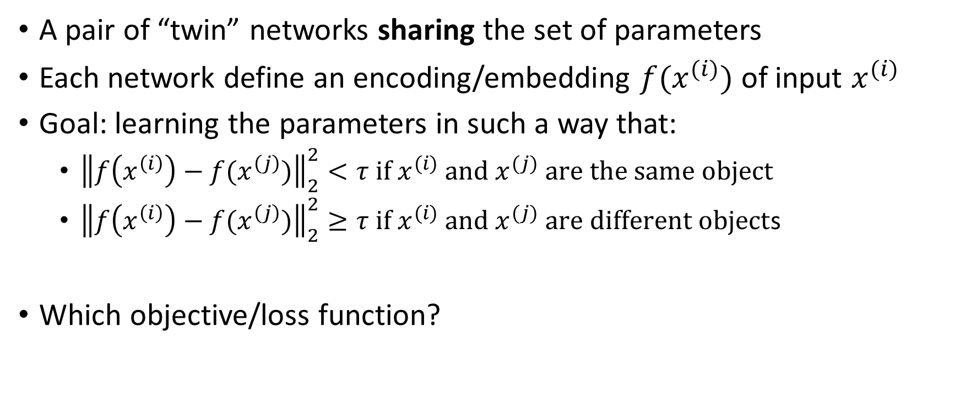
Siamese network
A pair of “twin” networks sharing the set of parameters
Each network define an encoding/embedding $f(x^{(i)})$ of input $x^{(i)}$
Goal: learning the parameters in such a way that:
  ${\left\|f\left(x^{\left(i\right)}\right)−f(x^{\left(j\right)})\right\|}_{2}^{2}<τ \text{if} x^{(i)} \text{and} x^{(j)} \text{are} \text{the} \text{same} \text{object}$
  ${\left\|f\left(x^{\left(i\right)}\right)−f(x^{\left(j\right)})\right\|}_{2}^{2}≥τ \text{if} x^{(i)} \text{and} x^{(j)} \text{are} \text{different} \text{object}$s
Which objective/loss function?

Slide 7
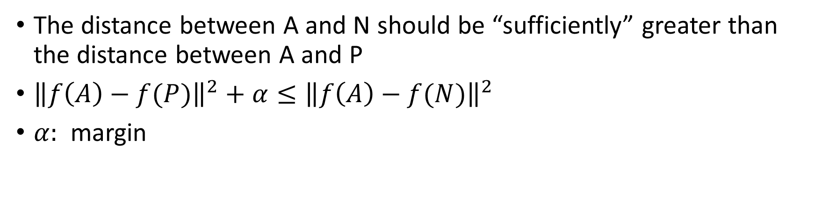
Triplet Loss
A
P
A
N
The distance between A and N should be “sufficiently” greater than the distance between A and P
${\left\|f\left(A\right)−f(P)\right\|}^{2}+α≤{\left\|f\left(A\right)−f(N)\right\|}^{2}$
$α:$ margin

Slide 8
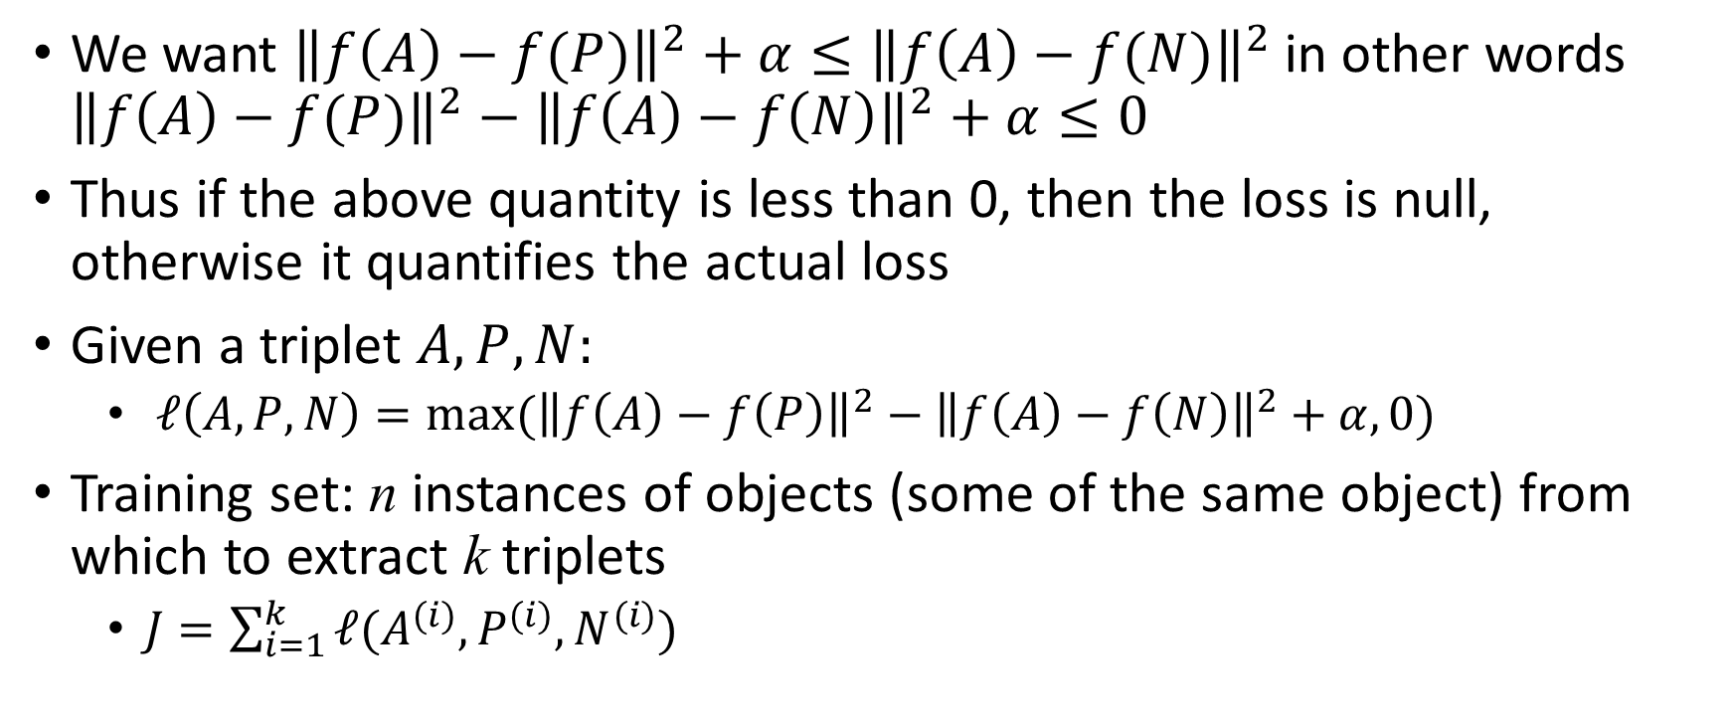
Triplet loss function
We want ${\left\|f\left(A\right)−f(P)\right\|}^{2}+α≤{\left\|f\left(A\right)−f(N)\right\|}^{2}$ in other words ${\left\|f\left(A\right)−f(P)\right\|}^{2}−{\left\|f\left(A\right)−f\left(N\right)\right\|}^{2}+α≤0$
Thus if the above quantity is less than 0, then the loss is null, otherwise it quantifies the actual loss
Given a triplet $A,P,N:$
  $ℓ\left(A,P,N\right)=max⁡({\left\|f\left(A\right)−f\left(P\right)\right\|}^{2}−{\left\|f\left(A\right)−f\left(N\right)\right\|}^{2}+α,0)$
Training set: n instances of objects (some of the same object) from which to extract k triplets
  $J=\sum_{i=1}^{k}{ℓ(A^{(i)},P^{(i)},N^{(i)})}$

Slide 9
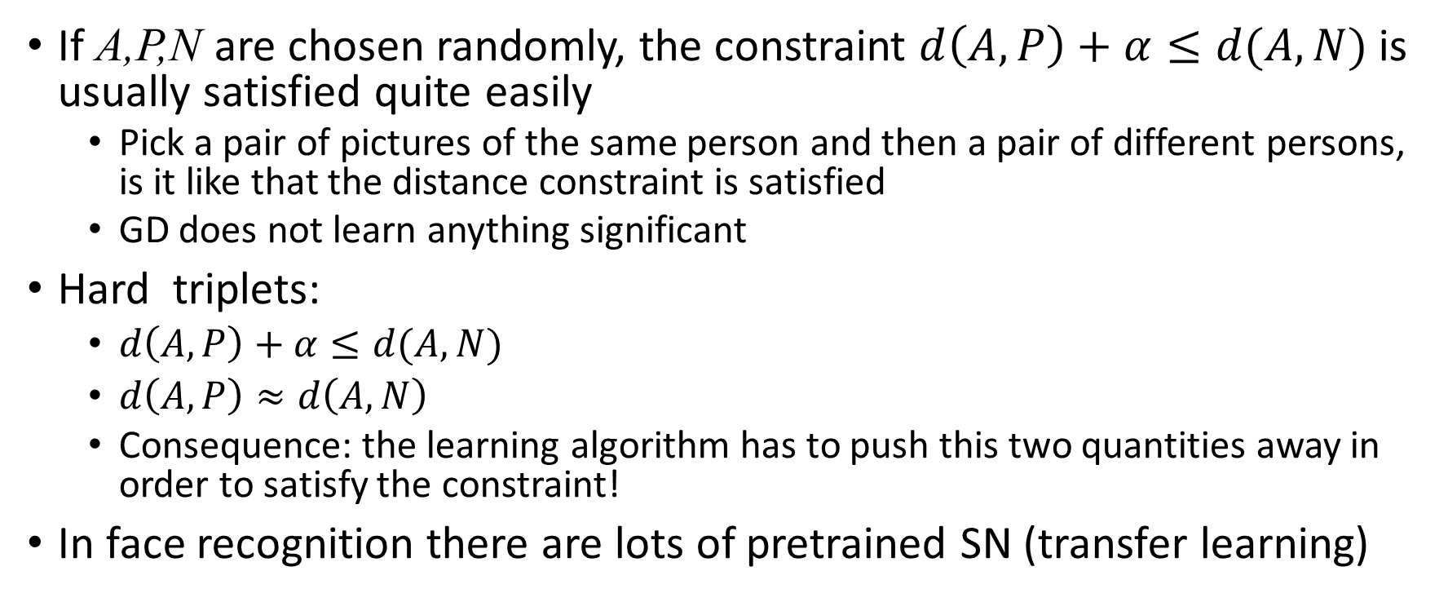
Choosing triplets
If A,P,N are chosen randomly, the constraint $d\left(A,P\right)+α≤d(A,N)$ is usually satisfied quite easily
  Pick a pair of pictures of the same person and then a pair of different persons, is it like that the distance constraint is satisfied
  GD does not learn anything significant
Hard triplets:
  $d\left(A,P\right)+α≤d(A,N)$
  $d\left(A,P\right)≈d\left(A,N\right)$
  Consequence: the learning algorithm has to push this two quantities away in order to satisfy the constraint!
In face recognition there are lots of pretrained SN (transfer learning)

Slide 10
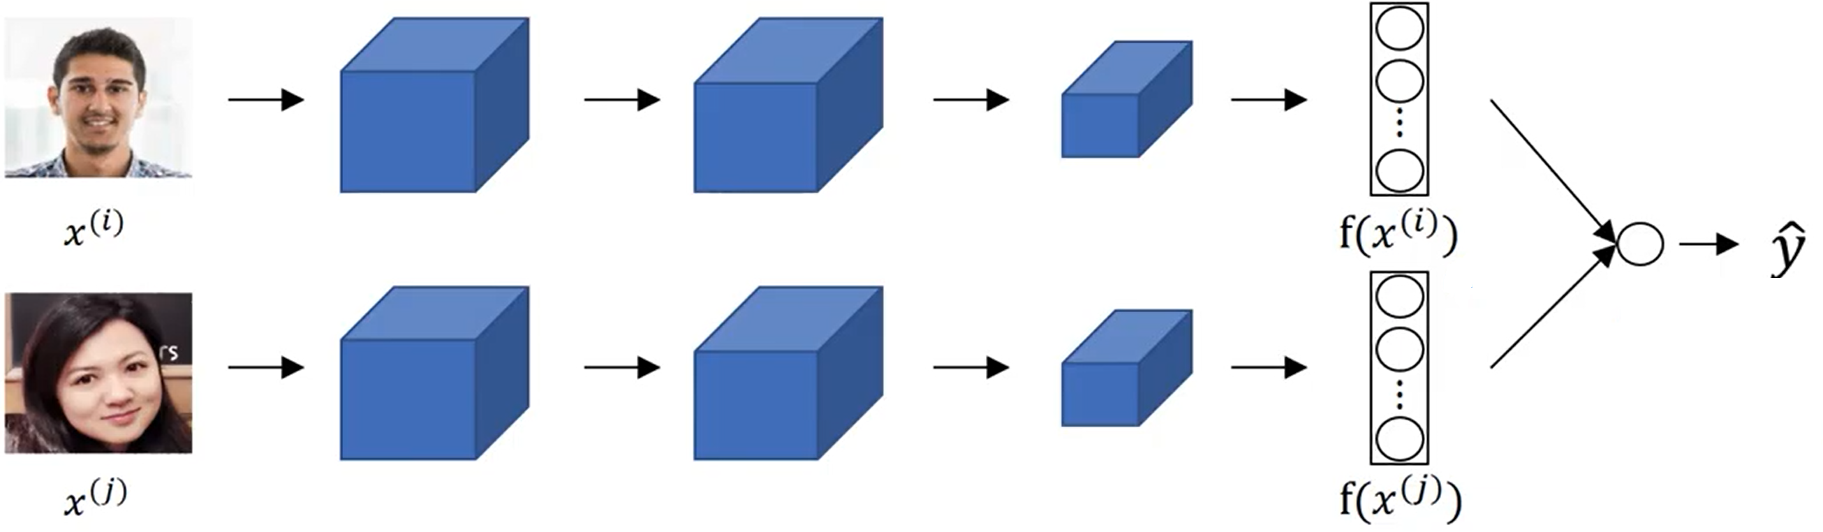
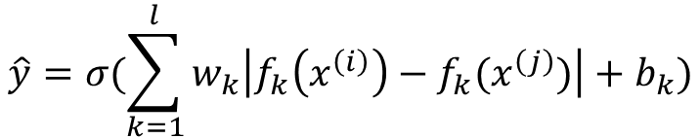
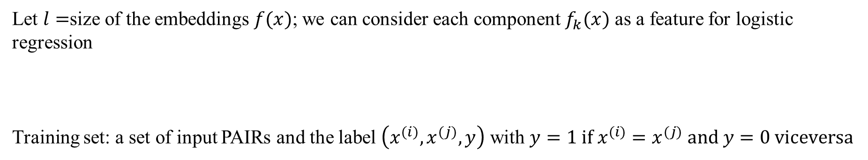
Object(Face) recognition as binary classification
Let $l=$size of the embeddings $f(x)$; we can consider each component $f_{k}(x)$ as a feature for logistic regression
Training set: a set of input PAIRs and the label $\left(x^{(i)},x^{(j)},y\right)$ with $y=1 \text{if} x^{(i)}=x^{(j)} \text{and} y=0 \text{viceversa}$
$$\hat{y}=σ(\sum_{k=1}^{l}{w_{k}\left|f_{k}\left(x^{\left(i\right)}\right)−f_{k}(x^{\left(j\right)})\right|+b_{k})}$$

Slide 11
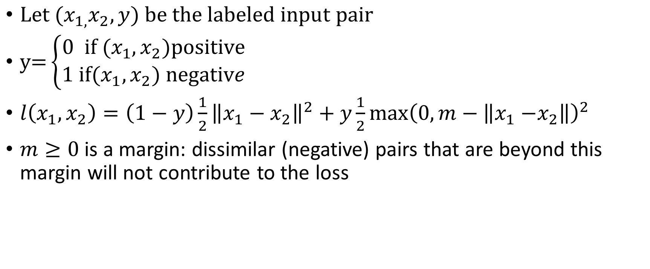
Contrastive loss
$\text{Let} {(x}_{1,}x_{2},y) \text{be} \text{the} \text{labeled} \text{input} \text{pair}$
$\text{y}\text{=}\left\{\begin{aligned}0 \text{if} (x_{1},x_{2})\text{positive} \\ 1 \text{if}(x_{1},x_{2}) \text{negativ}e\end{aligned}\right.$
$l\left(x_{1},x_{2}\right)=\left(1−y\right)\frac{1}{2}{\left\|x_{1}−x_{2}\right\|}^{2}+y\frac{1}{2}\max{{\left(0,m−\left\|x_{1}{−x}_{2}\right\|\right)}^{2}}$
$m≥0$ is a margin: dissimilar (negative) pairs that are beyond this margin will not contribute to the loss

Slide 12
Contrastive Loss Function (optional)
https://medium.com/@maksym.bekuzarov/losses-explained-contrastive-loss-f8f57fe32246

Slide 13
N-PAIR LOSS

Slide 14
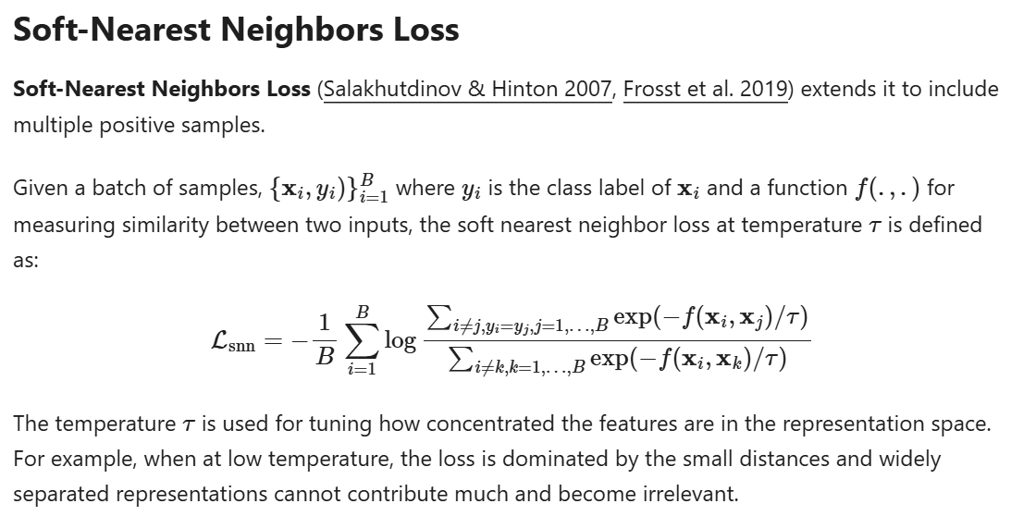

Slide 15
SIMCLR

